Slide 1

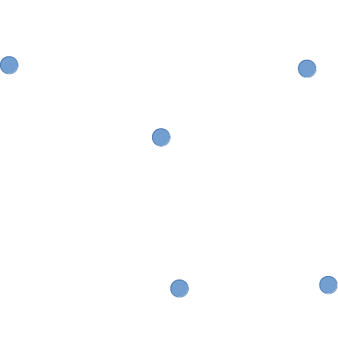
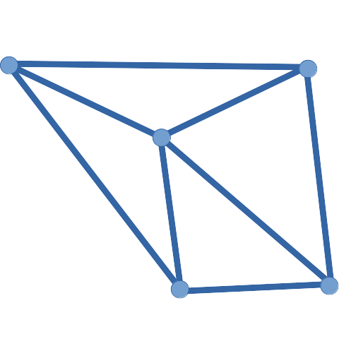
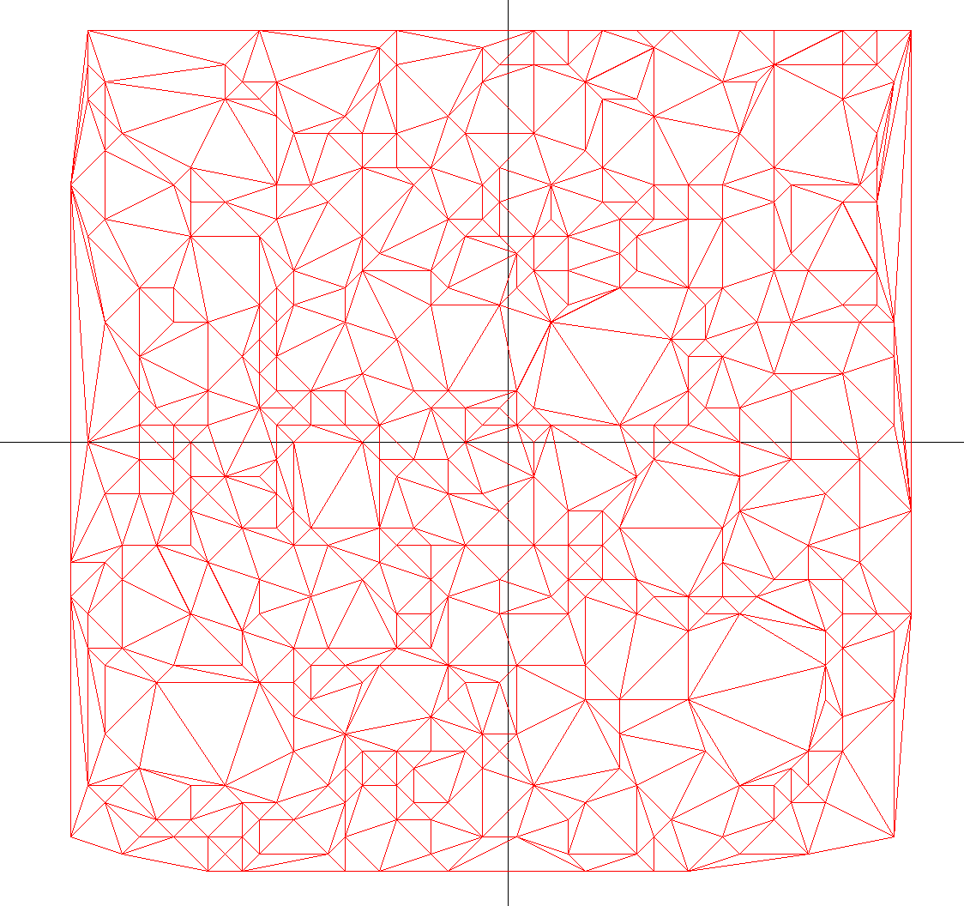
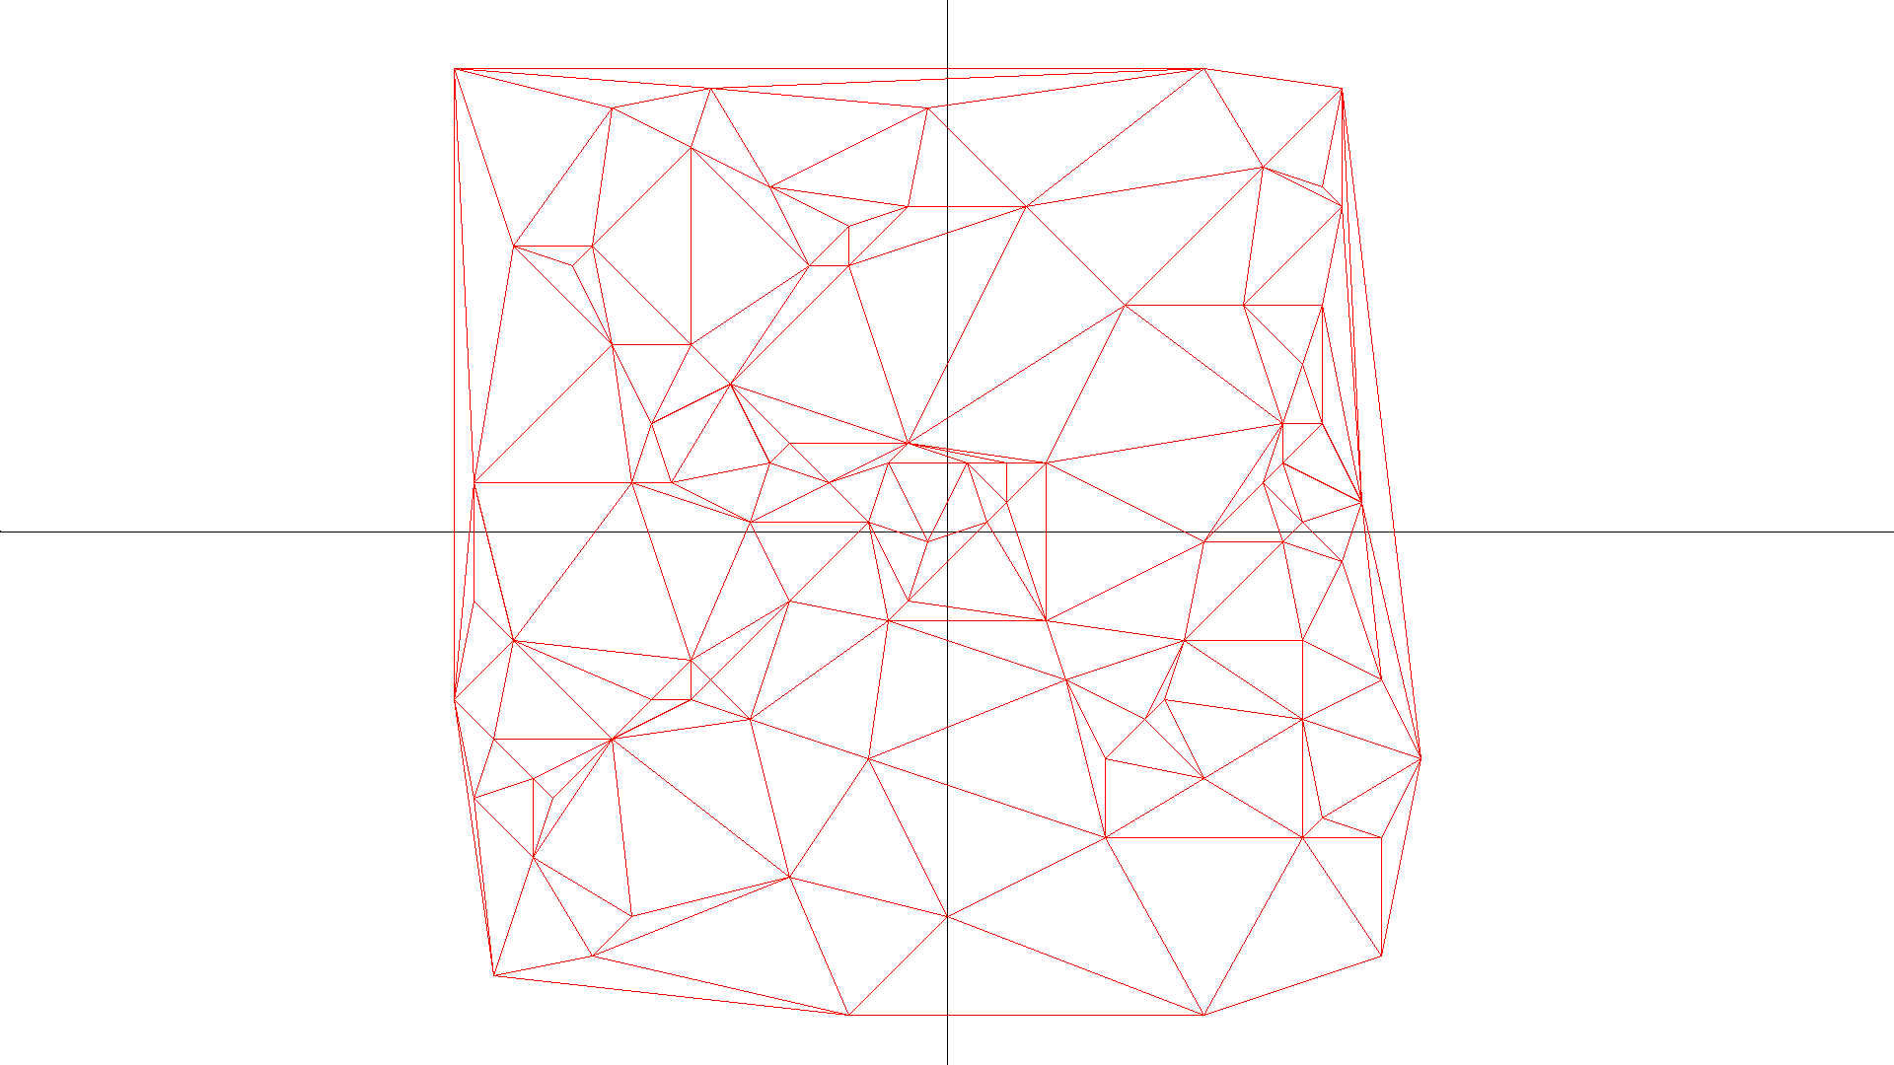
Greedy Triangulation
Eliza Shoemaker and Randy Shoemaker
The Problem
Parallelizing the Algorithm
Our goal is to take a set of points in the plane (called the point set) and produce the greedy triangulation. An example of a triangulation of a point set is shown in Figures 1 and 2. Different algorithms can be used to produce a triangulation. Greedy Triangulation algorithms greedily build a triangulation of a point set by successively adding the smallest line segment between any two points.
Phase One:
First we distribute a subset of the points to each process. Each process calculates all the lines occurring between its points. Using a binomial tree structure, each process sends its points or receives another process’s points. At this step all the lines between the process’s `old’ points and its `new’ points are generated. We repeat until all lines are on one process. Finally the lines are distributed to all other processes.
Phase Two:
Each process sorts its lines from smallest to largest length. Quick sort, provided by the C library is used to perform the sort.
Phase Three:
Each process selects its smallest line and sends it to process 0. Process 0 finds the globally smallest line and adds it to the triangulation before broadcasting it to the other processes. Each process then throws out all lines intersecting the globally smallest line. This is repeated until each process has exhausted their set of lines.
Progress
We currently have a working parallel version. <INSERT ANALYSIS HERE>
Points | Serial | 1 P | 2 P | 4 P | 8 P | 16 P | 32 P | 64 P
0707 | 0.0114 | 0.0463 | 0.0321 | 0.0346 | 0.0248 | 0.0824 | 0.1071 | 0.1232
1000 | 0.0227
1414 | 0.0431
2000 | 0.0843
2828 | 0.1670 | 0.7180 | 0.4693 | 0.3711 | 0.3846 | 0.1275 | 1.666 | 1.8390
Fig 1. A point set
Fig 2. Triangulation of the point set in Figure 1
Greedy Triangulation algorithms have been used to help tackle more complicated problems such as the Minimum Weight Triangulation problem (MWT) [1]. The greedy triangulation has been used to give approximations of solutions for the Minimum Weight Triangulation (MWT) problem which is NP-hard [2]. MWT seeks to minimize the sum of the lengths of the segments forming the triangulation.
The greedy triangulation algorithm used in this work is an O(n⁴) algorithm. The triangulation is created in three phases. Phase one consists of generating all line segm. In the second phase the line segments are sorted from smallest to largest. In the final phase the triangulation is produced by successively selecting the smallest line segment and throwing out all line segments which intersect it. Once phase three is complete the point set has been triangulated. We implemented a serial version of this algorithm and a parallel distributed memory version using the Message Passing Interface (MPI) for C. The serial version runs on one processor and the parallel runs on multiple processors which communicate with each other.
Points | Serial | 1 P | 2 P | 4 P | 8 P | 16 P | 32 P | 64 P
0707 | 0.0533 | 0.0532 | 0.0258 | 0.0200 | 0.0105 | 0.0053 | 0.0026 | 0.0014
1000 | 0.1089
1414 | 0.2251
2000 | 0.4680
2828 | 0.9718 | 0.9771 | 0.4776 | 0.2583 | 0.2023 | 0.0996 | 0.0481 | 0.0231
Points | Serial | 1 P | 2 P | 4 P | 8 P | 16 P | 32 P | 64 P
0707 | 8.6597 | 11.469 | 5.8571 | 3.5034 | 2.0227 | 1.2410 | 1.0573 | 1.2641
1000 | 26.493
1414 | 93.425
2000 | 338.93
2828 | 1183.3 | 1920.1 | 953.18 | 558.72 | 353.40 | 193.04 | 95.516 | 47.2552
Future Work
We plan to improve our parallel version by using multi-threading on each process to see if more speed up can be achieved.
We used a pseudo-random number generator called a linear congruential generator (LCG) to generate inputs for our triangulation programs. Future research could involve investigating how “random” the LCG is using graphical outputs from our software.
References
[1] Jesper Jansson. Planar Minimum-Weight Triangulations. Lund University, Sweden. Retrieved from https://www.semanticscholar.org/
[2] Mulzer, Wolfgang, and Günter Rote. "Minimum-weight triangulation is NP-hard." Journal of the ACM (JACM) 55.2 (2008): 11.

